Slide 1




NEXT GEN EMPLOYABILITY PROGRAM
Creating a future-ready workforce
Team Members
College Name
Student Name : Nishanth MG
Student ID :720921104070
Jct College of Engineering & Technology-Coimbatore
Notes:
1

Slide 2

CAPSTONE PROJECT SHOWCASE
Project Title
Notes Sharing Web Application using Django Framework
Abstract | Problem Statement | Project Overview | Proposed Solution | Technology Used | Modelling & Results | Conclusion

Slide 3
Abstract
In the digital era, the need for efficient and accessible educational resources is more pronounced than ever. This paper presents the development of a collaborative notes sharing web application designed to meet this demand by facilitating the sharing of academic materials among students. Utilizing the Django framework, a high-level Python web framework that encourages rapid development and pragmatic design, this application offers a robust platform for users to upload, download, and share notes in various formats. The system architecture is built on Django's Model-View-Template (MVT) architecture, ensuring a clear separation of concerns, scalability, and ease of maintenance. Key features include user authentication, file management, a search functionality for ease of access to specific materials, and a categorization system for organizing notes by subject, topic, or course. Preliminary testing indicates a user-friendly interface and a positive reception from the target audience, suggesting the application's potential to significantly enhance the learning experience by promoting collaborative study and resource sharing. Future work will focus on incorporating advanced features such as collaborative editing, integration with cloud storage services, and the implementation of machine learning algorithms to recommend personalized content to users based on their interests and study habits.
Source :Gpt 4

Slide 4
Problem Statement
The primary challenge addressed by this project is the lack of an intuitive, efficient, and collaborative platform specifically designed for the sharing and management of academic notes and resources among students and educators. Despite the availability of various online platforms, there remains a significant gap in services that cater specifically to academic collaboration, with many students resorting to fragmented and less secure means of sharing study materials. This project aims to leverage the Django framework to develop a user-friendly, secure, and scalable web application that not only facilitates the easy sharing and organization of notes but also enhances the overall learning experience through collaborative features and a community-driven approach.
Source :

Slide 5
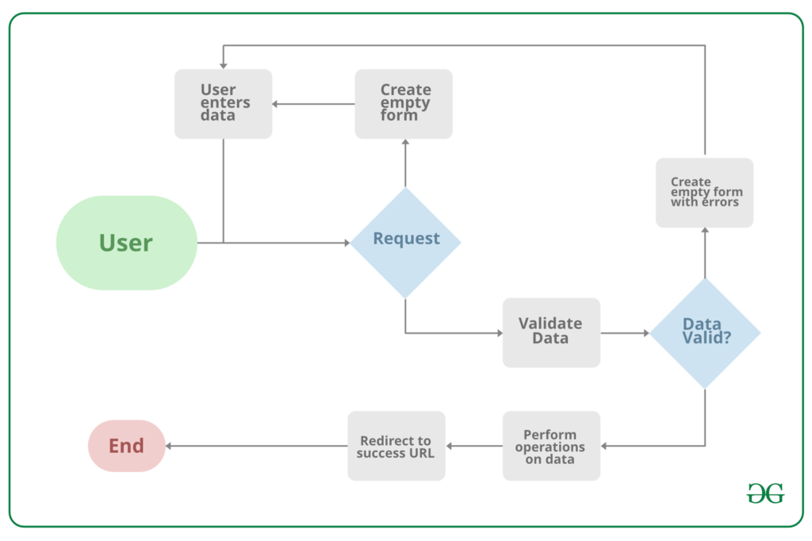
Project Overview
Source :google

Slide 6
Proposed Solution
The proposed solution is to develop a comprehensive, secure, and user-friendly Notes Sharing Web Application tailored for students, educators, and academic institutions. This application will leverage the Django framework for its robustness, security features, and scalability. Below are the key components of the proposed solution:
1. System Architecture
Backend Development: Utilize Django for server-side logic, database management, user authentication, and session management, ensuring a secure and efficient backend structure.
Frontend Integration: Employ HTML, CSS, and JavaScript, alongside Django’s template system, to create an intuitive and responsive user interface that enhances user experience.
Database Design: Design a relational database schema that efficiently stores user data, notes, categories, and interactions to facilitate quick retrieval and secure storage of information.
2. Core Features
User Authentication and Authorization: Implement Django’s built-in authentication system to manage user accounts, secure login/logout processes, and ensure user data privacy.
Notes Management: Enable users to upload, download, and manage notes in various formats (PDF, DOCX, PPT, etc.), with features for creating, editing, and deleting notes.
Collaboration Tools: Incorporate features for users to comment on notes, rate them, and engage in discussions, fostering a collaborative learning environment.
.
Source : GPT 4

Slide 7
3. Security and Privacy
Implement Django’s security best practices to protect against common vulnerabilities such as SQL injection, Cross-Site Scripting (XSS), and Cross-Site Request Forgery (CSRF).
Ensure data privacy by adhering to regulations such as GDPR for the handling of personal information.
4. Scalability and Performance
Design the application with scalability in mind, allowing for easy adaptation to increased user numbers and data volume without performance degradation.
Utilize Django’s caching framework to enhance application performance and reduce server load.
5. User Experience (UX) Design
Follow a user-centered design approach to create an accessible and engaging platform, ensuring that the UI/UX caters to the needs and preferences of the target audience.
Implement responsive design principles to ensure the application is accessible across various devices and screen sizes.
6. Testing and Quality Assurance
Conduct thorough testing, including unit tests, integration tests, and user acceptance testing (UAT), to ensure the application is reliable, secure, and user-friendly.
Utilize Django’s testing framework to automate test cases and ensure code integrity.
Source :GPT 4

Slide 8
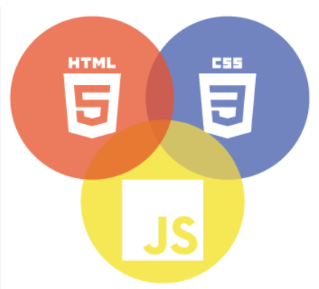

Technology Used
Front-end
Back-end
Source :

Slide 9
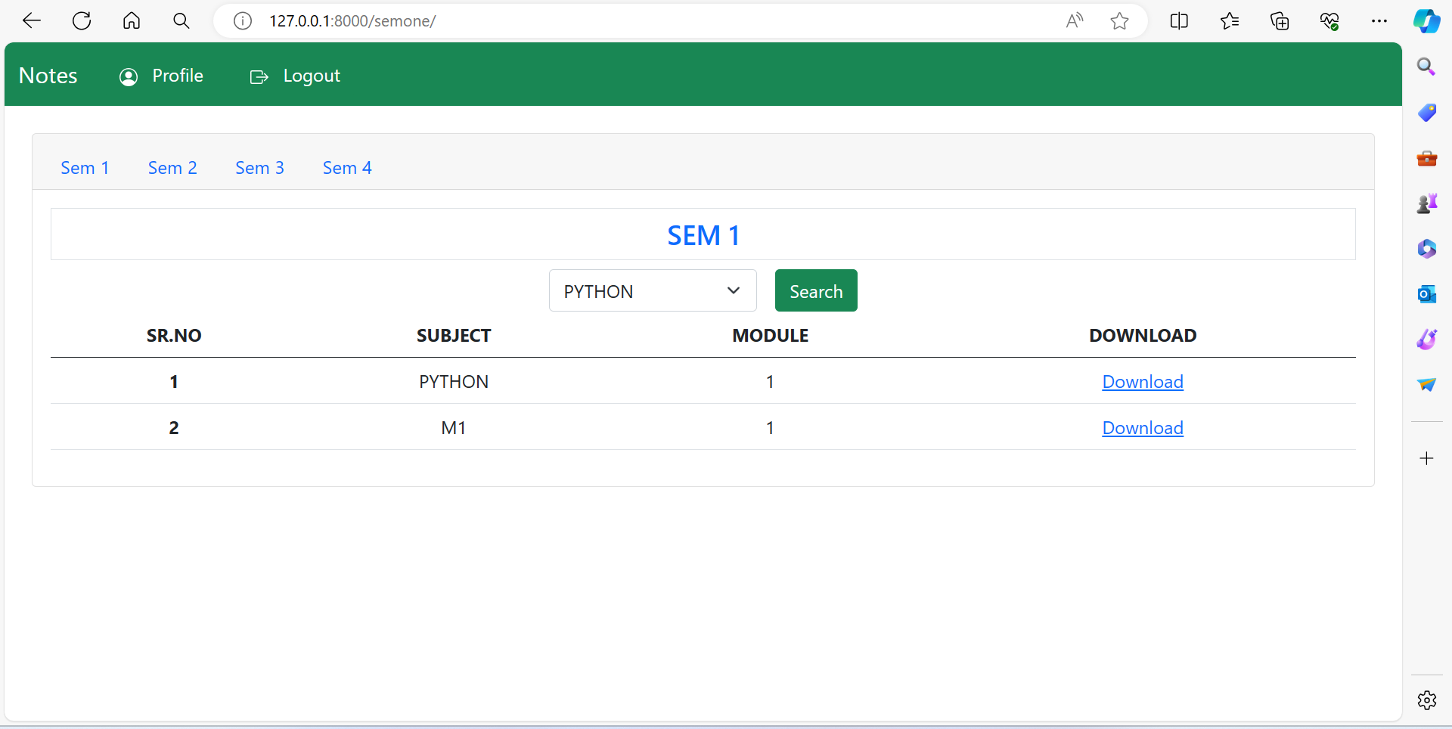
Modelling & Results
Source :

Slide 10
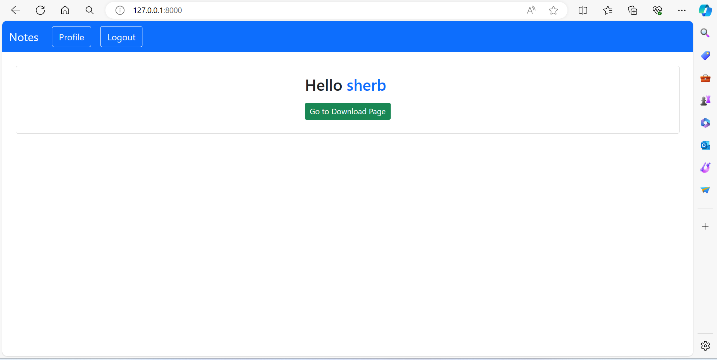
Homepage

Slide 11
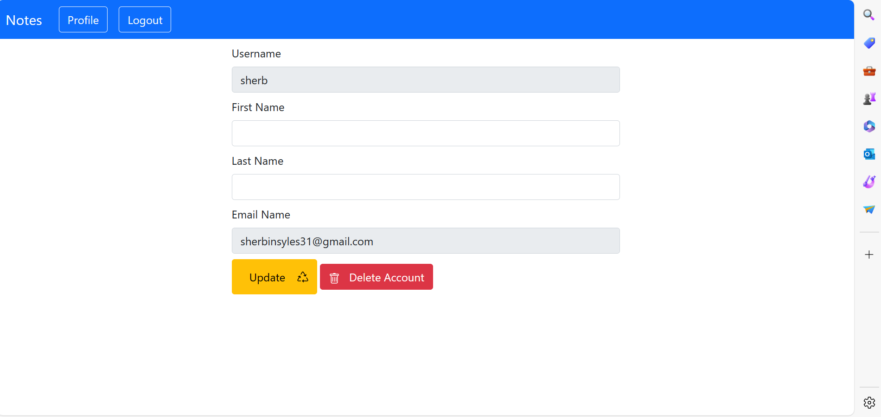
User-Profile

Slide 12
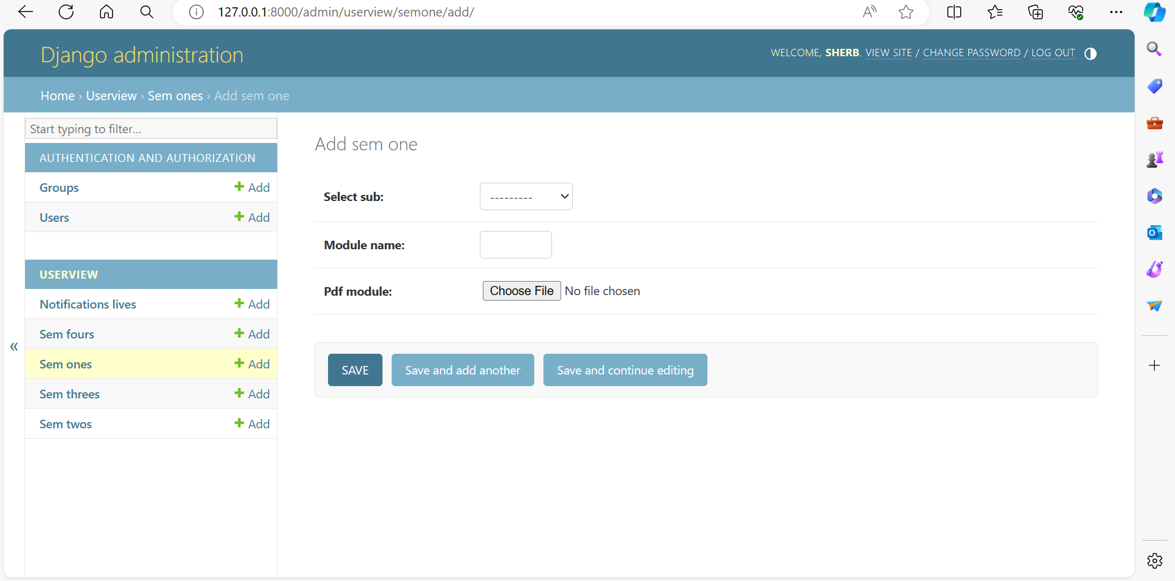
Admin-Page

Slide 13
Departments-Page

Slide 14
Future Enhancements:
1. Artificial Intelligence and Machine Learning Integration
Content Recommendation System: Implement machine learning algorithms to analyze user behavior, preferences, and interactions with the content to provide personalized note recommendations.
Automatic Categorization: Utilize natural language processing (NLP) techniques to automatically categorize notes based on their content, making the upload process more efficient and improving the discoverability of resources.
2. Enhanced Collaboration Features
Real-Time Collaboration: Introduce real-time editing and commenting features, allowing multiple users to work on the same document simultaneously, similar to Google Docs.
Study Groups: Enable users to create and join study groups within the application, fostering a more organized and collaborative learning environment.
3. Integration with External Platforms
Cloud Storage Services: Offer integration with cloud storage platforms (e.g., Google Drive, Dropbox) to allow users to easily upload and backup their notes.
Educational Tools and Platforms: Integrate with other educational platforms and tools, providing a seamless experience for users to access a wide range of resources and tools from within the application.

Slide 15
Conclusion
In conclusion, note sharing applications serve as versatile tools that facilitate collaboration, knowledge exchange, and organization across various domains. Whether utilized for educational purposes, professional endeavors, or personal organization, these platforms offer a centralized hub for users to create, share, and collaborate on notes. By promoting efficient communication, enhancing productivity, and fostering learning and growth, note sharing applications play a crucial role in empowering individuals, teams, and communities to connect, collaborate, and succeed in today's digital age. As technology continues to evolve, the significance and impact of note sharing applications are expected to grow, providing invaluable support for collaboration and knowledge sharing in diverse contexts.
Source :

Slide 16
Thank You!
Notes:
Thank You !!

